Slide 1
Cartilage and Bone

Slide 2
Bone and bone growth
Osseointegration

Slide 3
Objectives: Cartilage
Identify and describe hyaline, elastic and fibrocartilage.
Describe the differences between the three types of cartilage.
Identify the extracellular matrix of chondrocytes.
Identify chondrocytes in each of hyaline, elastic and fibrocartilage.
Identify isogenic groups.
Locate and identify the perichondrium in hyaline and elastic cartilage.
Describe the function of the perichondrium.
Describe the similarities and differences between cartilage and bone.
Describe where each type of cartilage is found in the body.
Describe the process of chondrogenesis and cartilage growth.
Describe and discuss the functions of each of the components.

Slide 4
Slides: Cartilage
Slide name | Slide number | Stain
Hyaline cartilage | 73 | H/E
Elastic cartilage | 9 | R/F
Fibrous cartilage | 10 | H/E

Slide 5
Objectives: Bone
Compare cartilage and bone with regard to cells, fibers, ground substance, function and growth.
Identify the parts of bone matrix.
Identify and describe the osteon and its components.
Identify and describe the cells involved in bone formation, growth and remodelling, namely osteoblasts, osteocytes and osteoclasts.
Identify compact bone and spongy bone.
Identify the growth plate and the zones present in the growth plate (zone of resting cartilage, proliferation, hypertrophy, calcification and ossification).
Describe the processes taking place in each of the zones of the growth plate.
Describe intramembranous bone development and endochondral ossification.
Discuss the process of bone formation, growth and remodelling, how the length and diameter of a long bone increases, and how this is reflected in the lamellar systems seen in bone at various ages.
Describe and discuss the functions of each of the components.

Slide 6
Slides: Bone
Slide name | Slide number | Stain
Compact bone (cross section) | 12 | H/E
Compact bone (ground cross section) | 13 | None
Compact bone (ground longitudinal section) | 14 | None
Bone development | 11 | H/E

Slide 7
All Slides
Draw and Annotate!
Consider 5 Items!

Slide 8
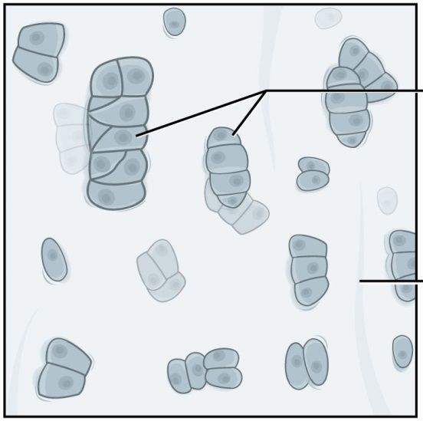
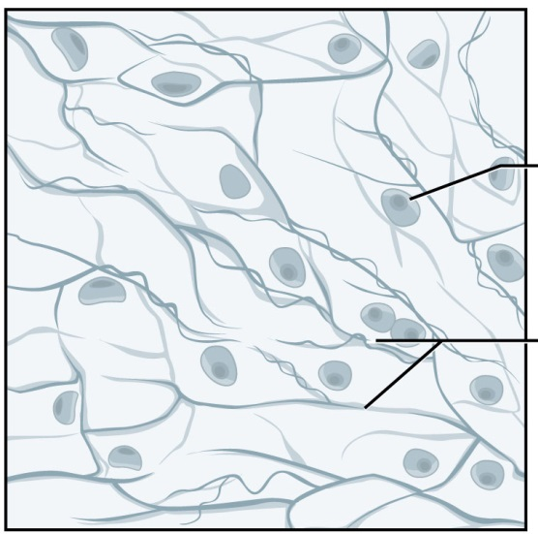
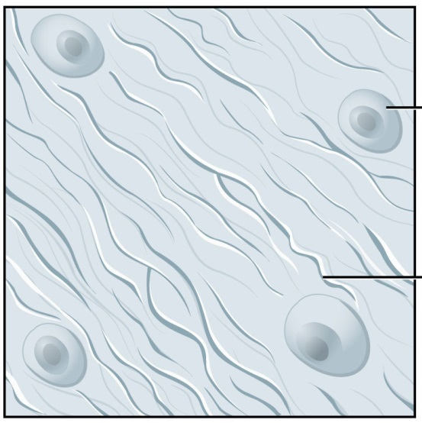
Identify & Annotate

Slide 9
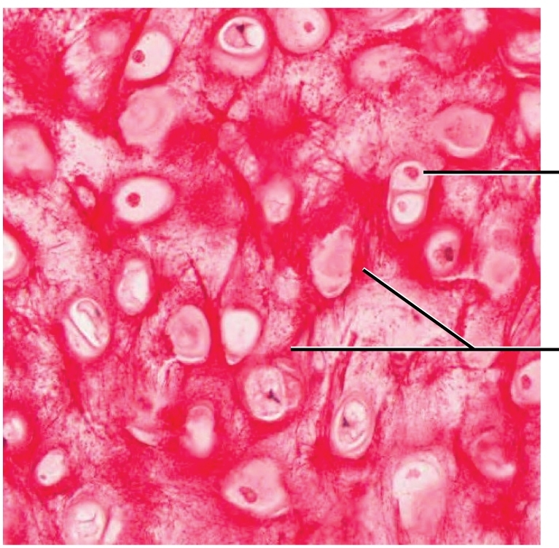
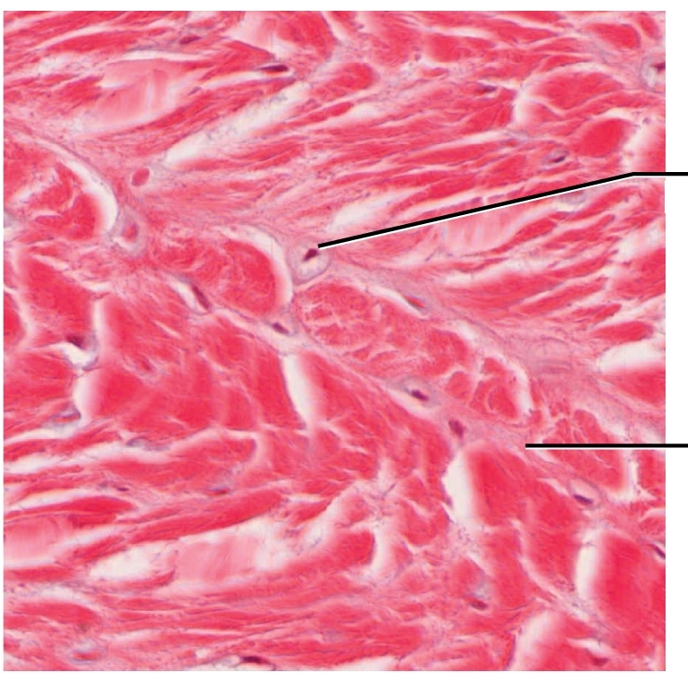
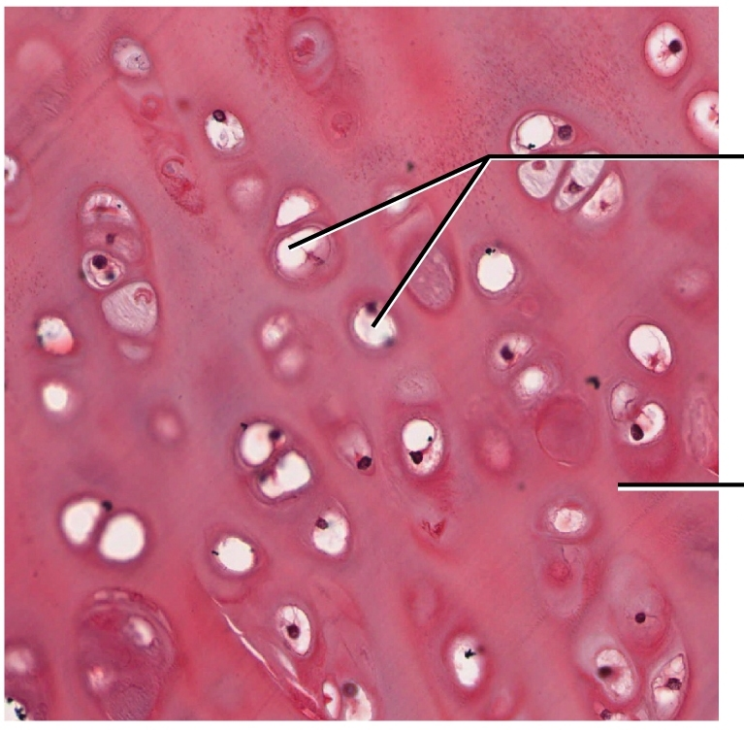
Identify & Annotate

Slide 10
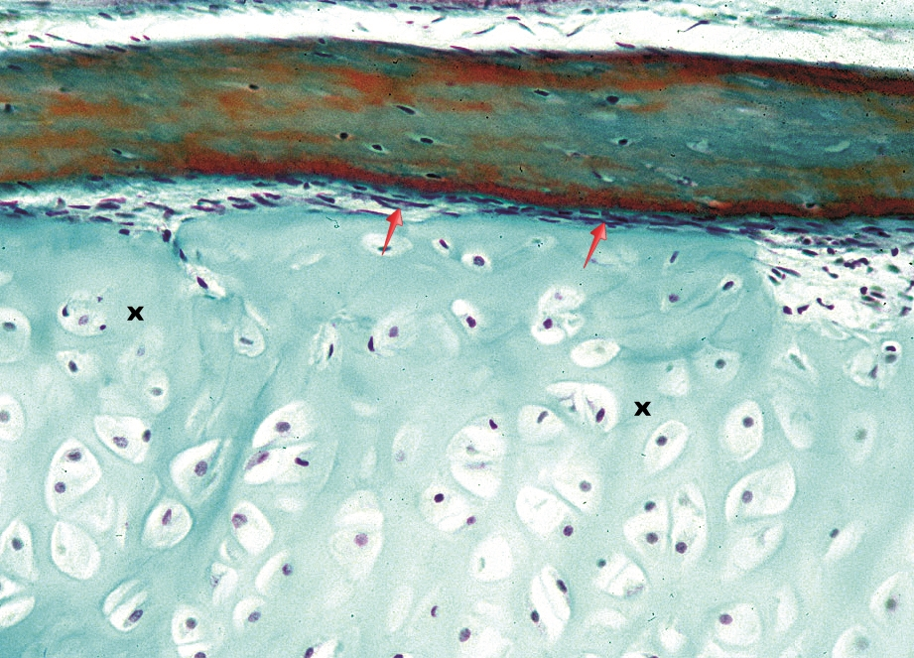
What structure is indicated by the red arrows?

Slide 11
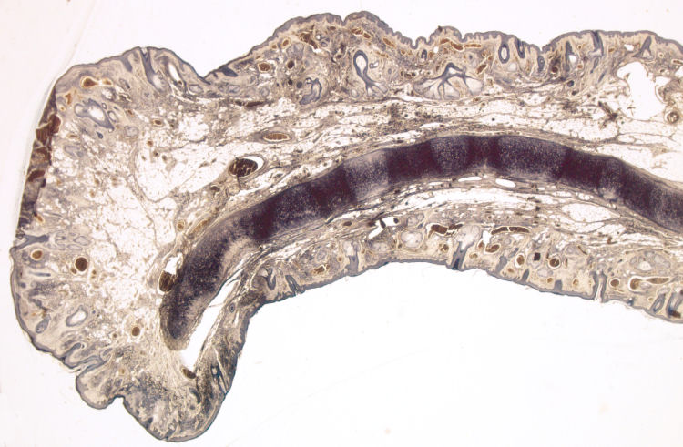
Slide 9: Macroscopic view of the external ear (work book pg 37)

Slide 12
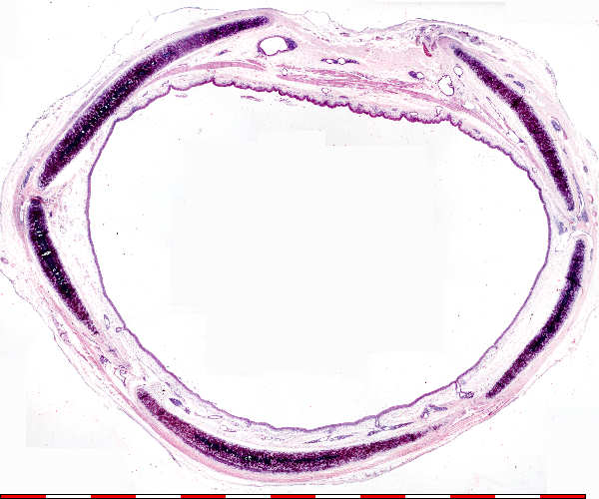
Slide 73: Macroscopic view of the trachea (work book pg 116)

Slide 13
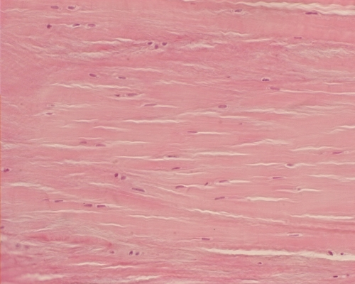
Slide 10: Fibrous cartilage (workbook pg 38)
Notes:
Fibrocartilage
Fibrocartilage has a dense arrangement of cartilage fibers that are arranged in an orderly manner. Numerous chondrocytes are located within their lacunae and are spaced between the fibers. Fibrocartilage is primarily composed of type I collagen, and is located in areas like the intervertebral discs and the pubic symphysis. Note that the chondrocytes are surrounded by a matrix which helps differentiate fibrocartilage from dense connective tissue.

Slide 14
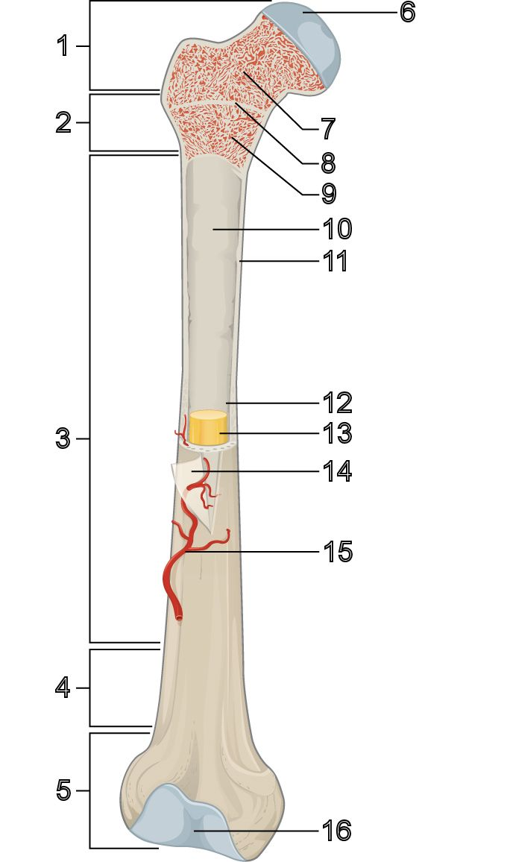
Draw and annotate

Slide 15
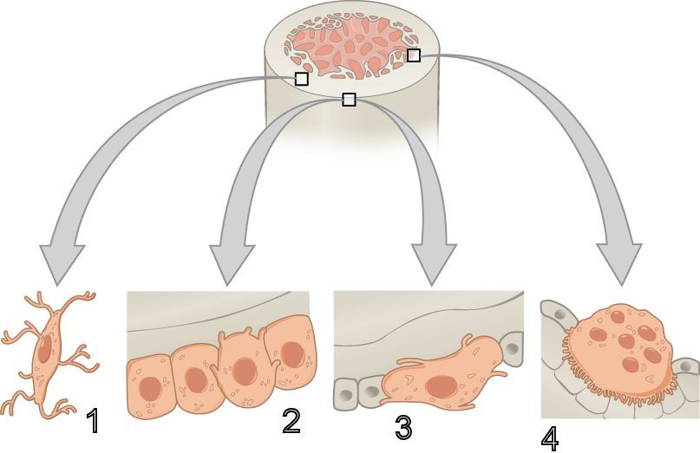
Draw - Identify – Describe - Function

Slide 16
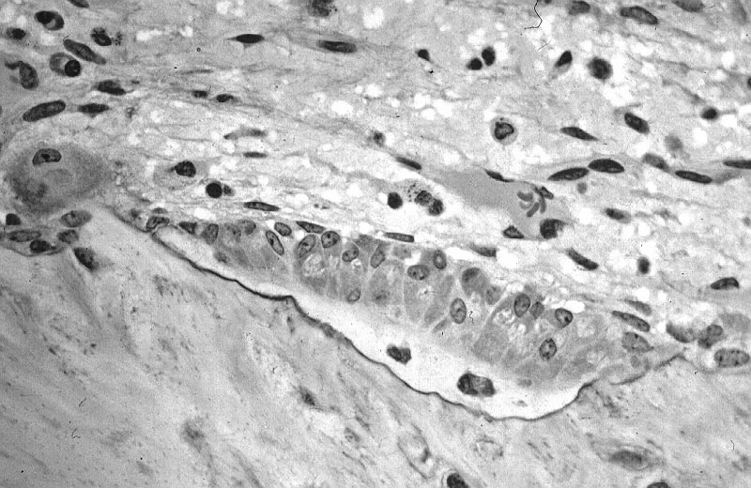
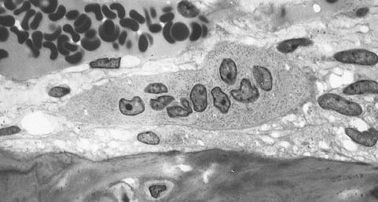
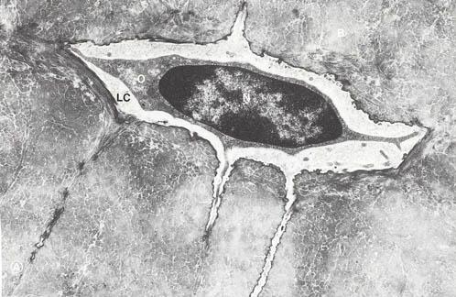
EM – Correlate with sketch

Slide 17
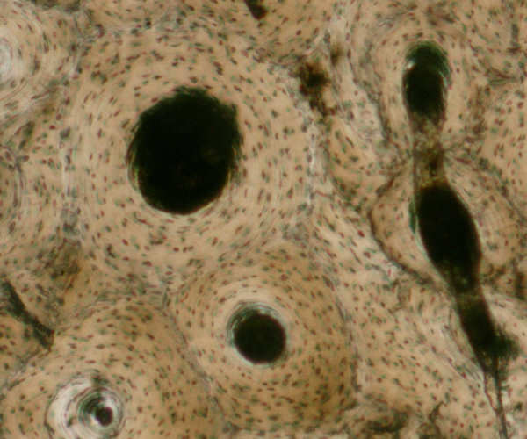
Slide 13: Cross section of a Haversian system (work book pg 42)

Slide 18
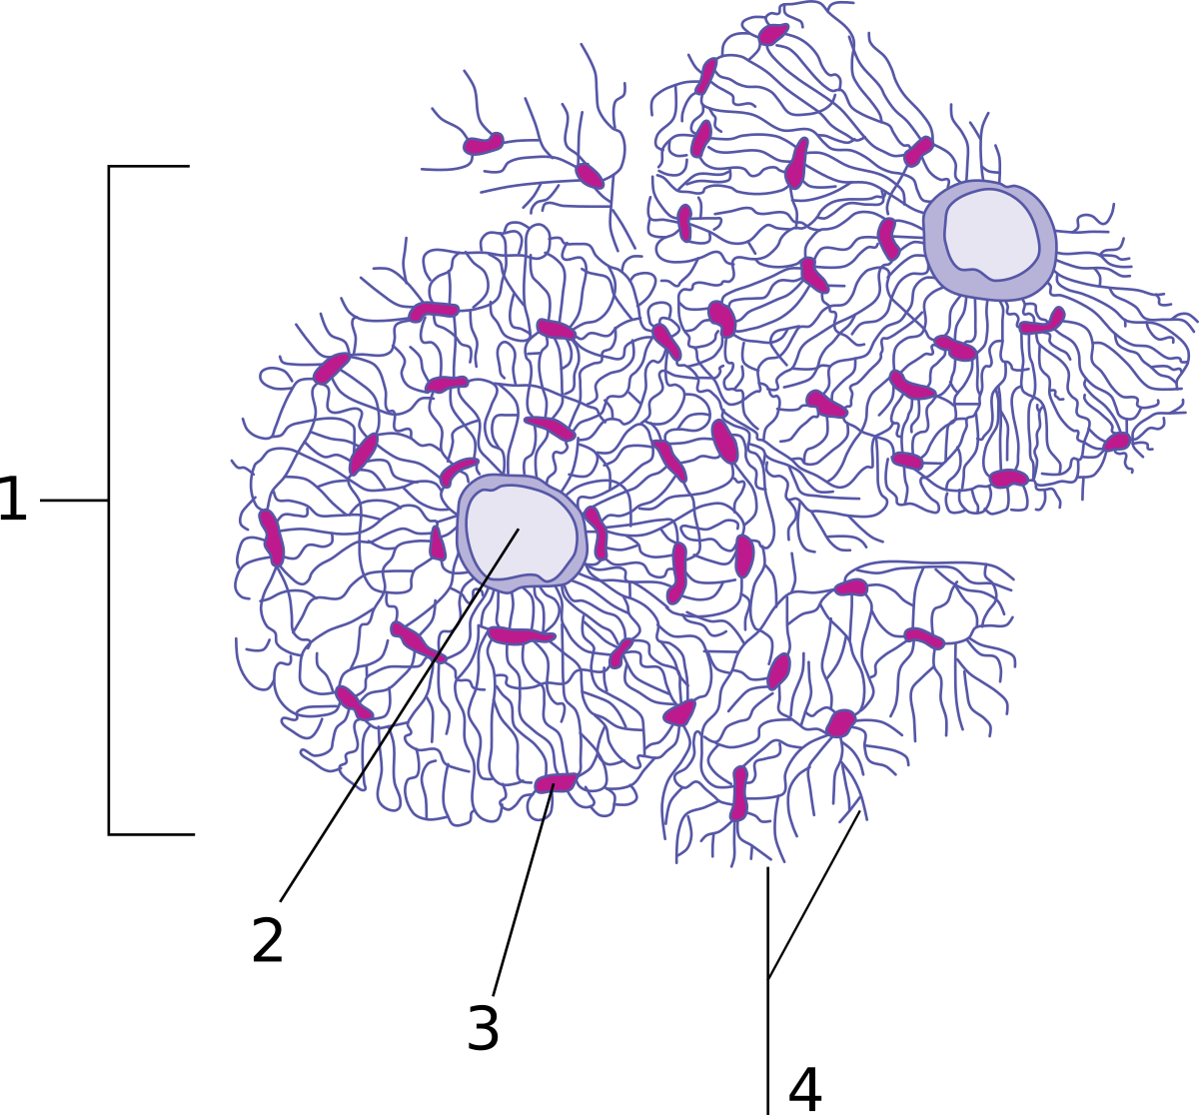
Diagram of osteon

Slide 19
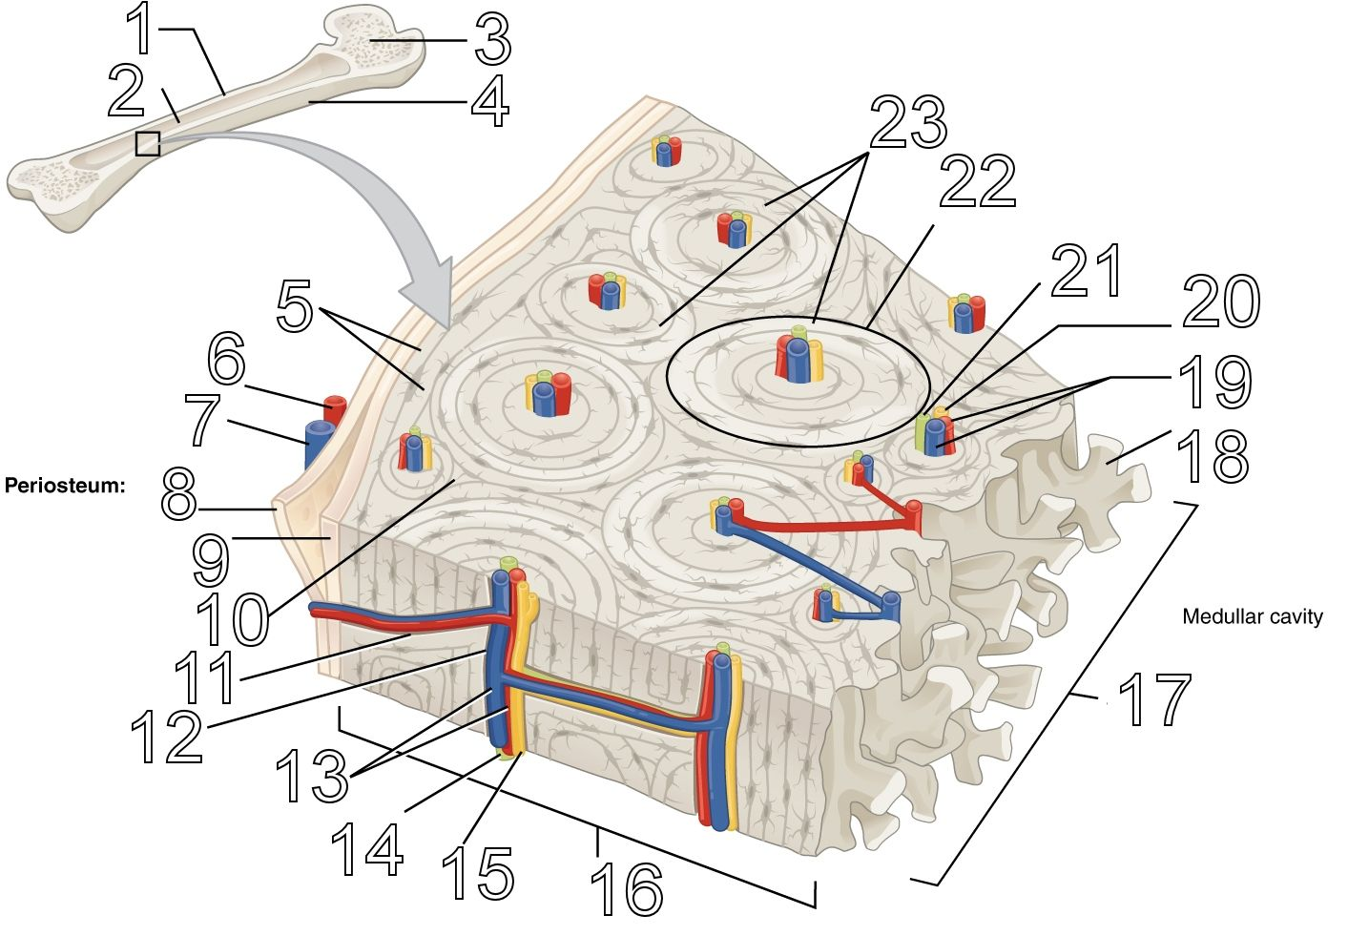
Diagram of compact bone

Slide 20
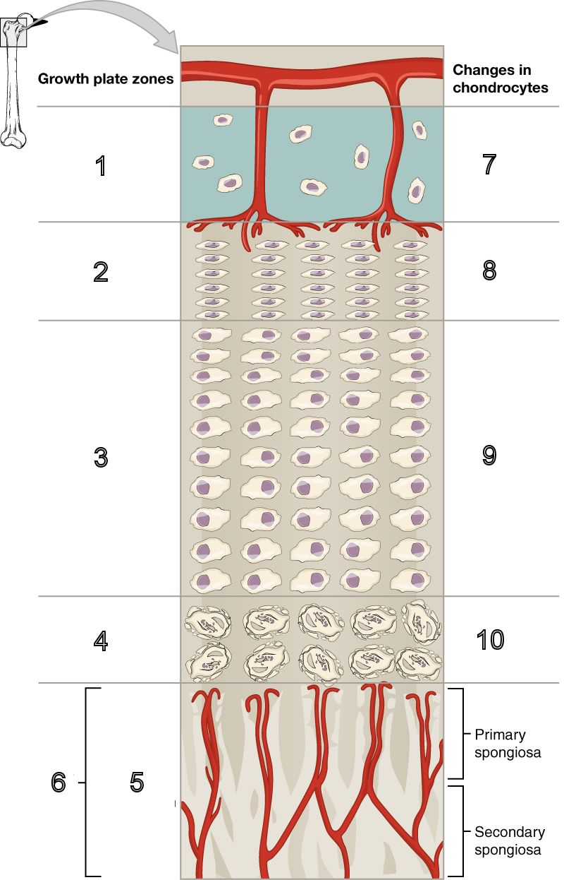
Longitudinal bone growth

Slide 21
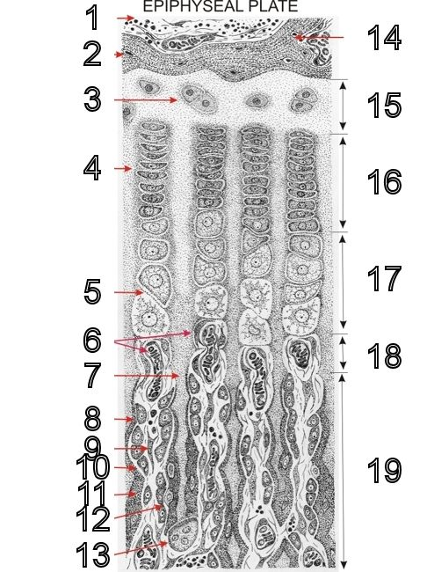
Longitudinal bone growth

Slide 22
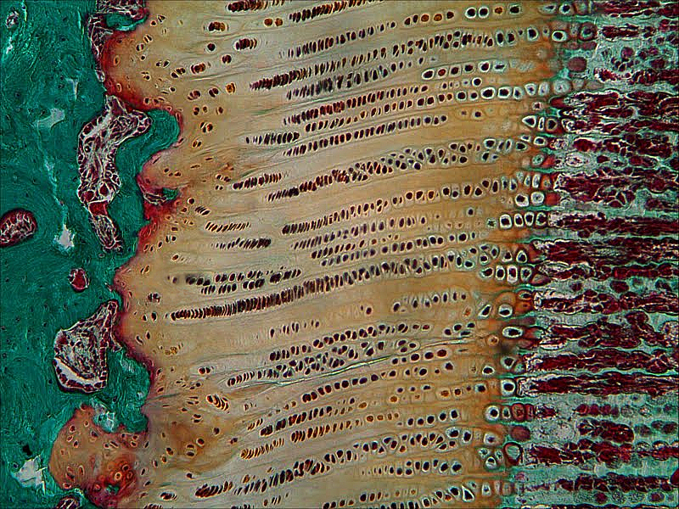
Slide 11: Bone development

Slide 23
Exit Ticket
Most important
What am I unsure about?

